Slide 1

Functions in Powershell

Slide 2
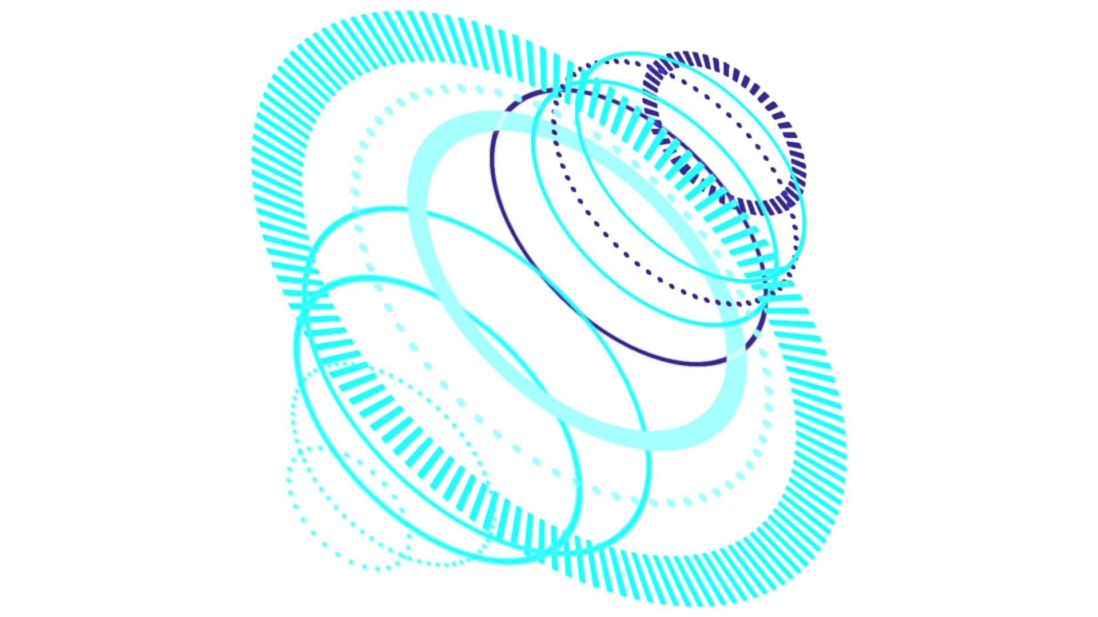
TABLE OF CONTENTS
What is a Function?
01
Parameters
02
Modules
03
Definition, Writing, and Calling Functions
What is a parameter and how to use it
How to make and use modules

Slide 3

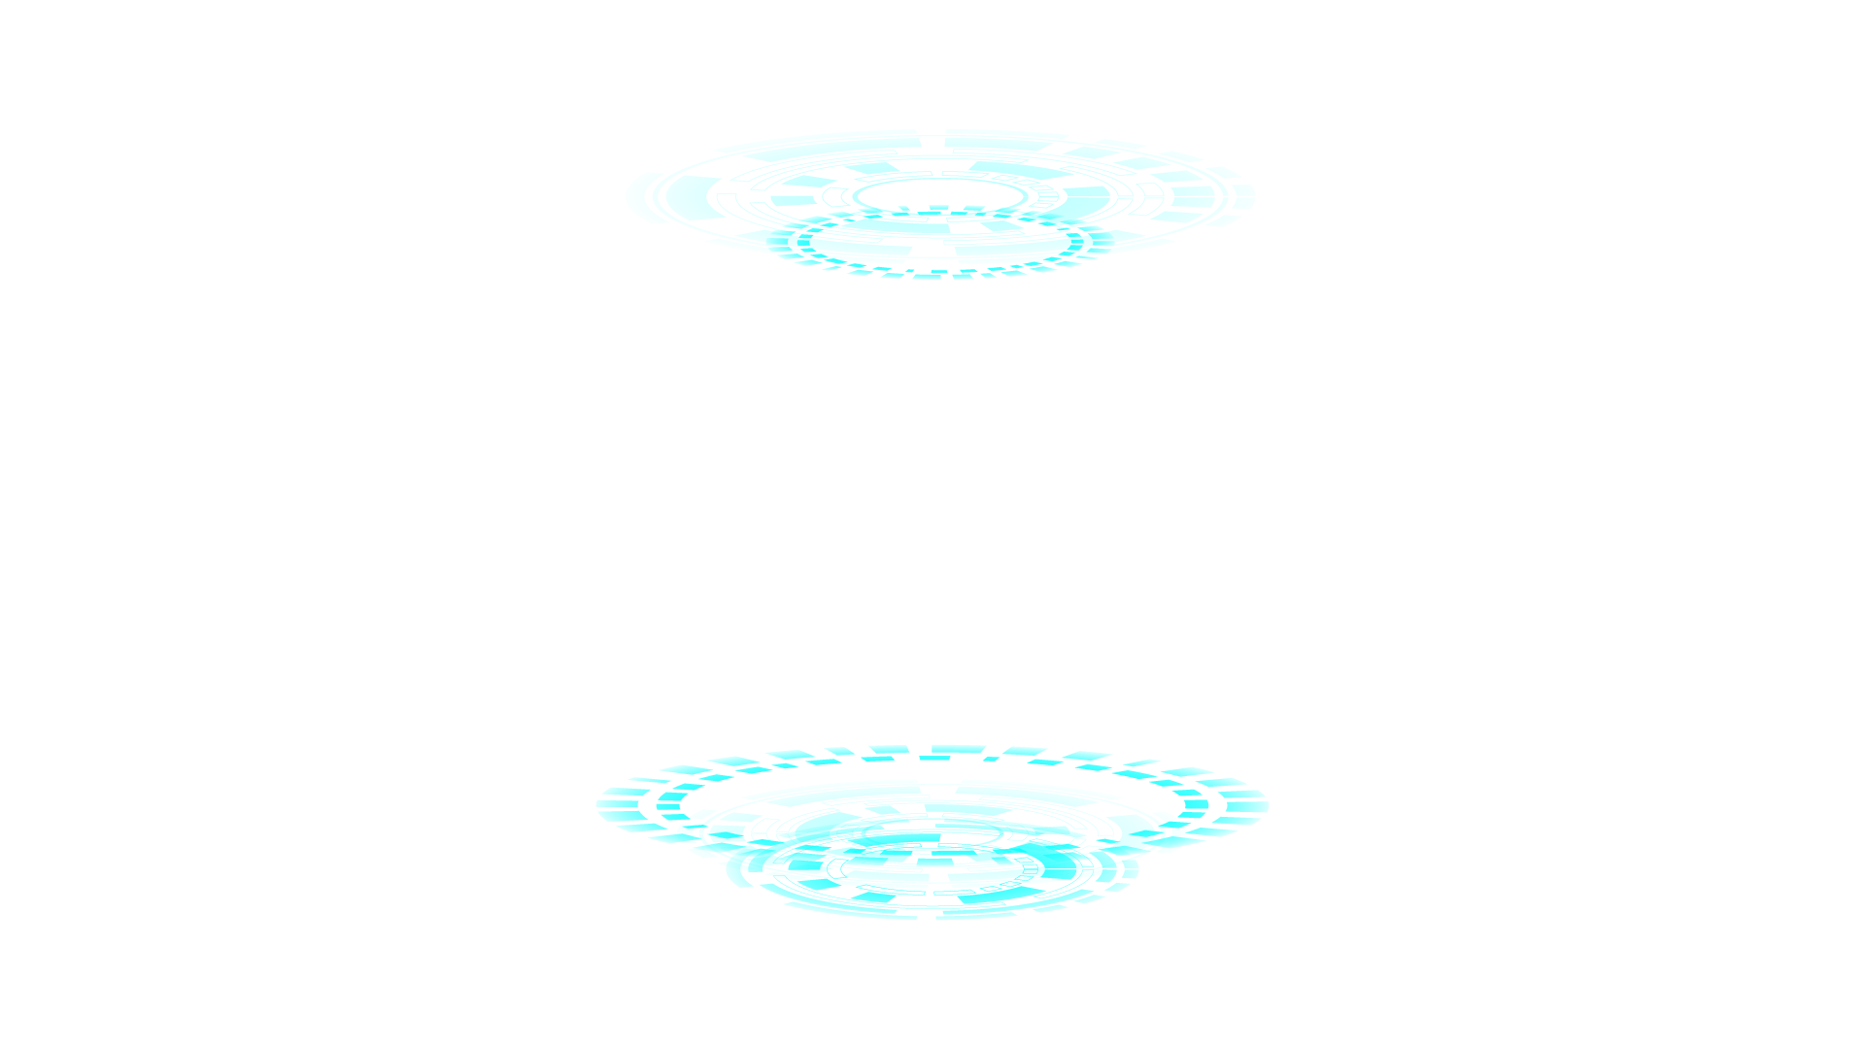
Functions
They are small blocks of code that can be recalled and make your code more complex yet simple and reusable

Slide 4
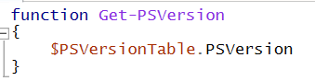

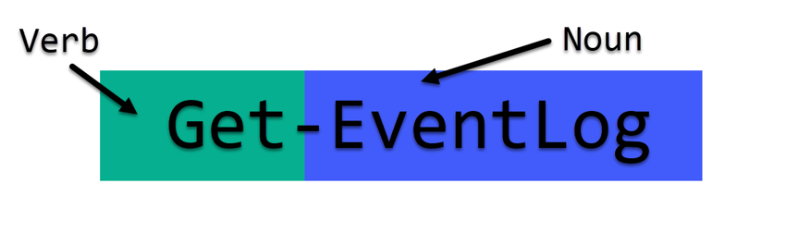
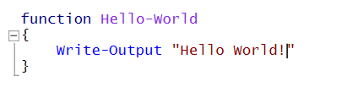
How to Write a Function
Write the command “function” followed by a valid cmdlet name
Write any code to be called by the function within the brackets
Be descriptive and unique in your function naming so as to avoid confusion
REMEMBER:
A cmdlet follows the VERB-NOUN format!

Slide 5
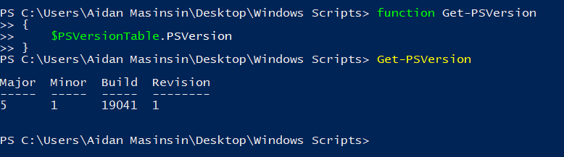
Calling a Function
To call a function, simply reference it like you would with a regular cmdlet
Functions will remain active within your current Powershell Terminal instance.
They can also be called within your Code via the Powershell ISE

Slide 6
Parameter
In computer programming, a parameter or a formal argument, is a special kind of variable, used in a subroutine to refer to one of the pieces of data provided as input to the subroutine.

Slide 7
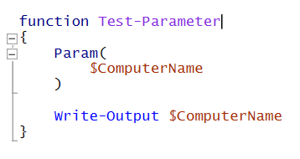
Adding Parameters
Parameters can be added by adding a Param() command to your function
Any variables set in this area will be specified as a parameter and can be used to receive input

Slide 8
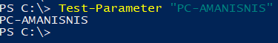
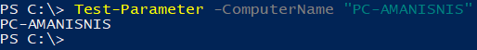
Receiving Parameters
There are 2 Ways to call parameter fields:
Implicit- Parameters are called in the order they are arranged
Explicit- Parameters are called explicitly by their variable names

Slide 9
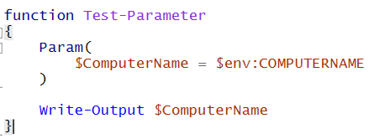
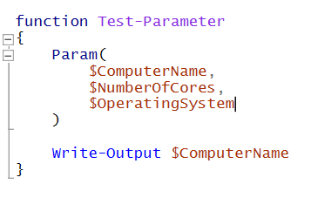
Multiple Parameters
Default Parameters
Multiple parameters can be set by listing them all out using commas to separate them. If called implicitly, they will be assigned in order of precedence. If explicitly, they can be called in any order by their variable name.
Default parameters are parameters that are predefined if no value is passed to them. These can be created by assigning values to the parameters in the param() command

Slide 10
Modules
A PowerShell module is a grouping of various functions that operate as a single mini program. Each module is stored in a folder where it contains the necessary files for the PowerShell commands.

Slide 11
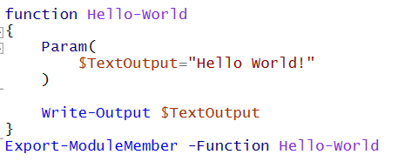
Modules
To create a module, make function(s) and add “Export-ModuleMember -Function Function-Name” to the end specifying the functions you want to import
Then save the file as a .psm1 to specify it as a module file

Slide 12
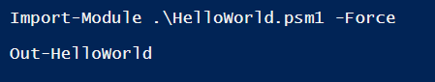
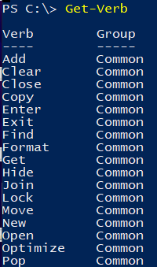
Importing Modules
You can import modules using the Import-Module command
Note: You must have valid function names in order to import them. To view valid verbs use the Get-Verb command

Slide 13
Thanks!
Slides by Zachary Dang
Edited by Aidan Masinsin

Slide 14


